Slide 1
CAR PRICE PREDICTION

Slide 2
Background
A Chinese automobile company Geely Auto aspires to enter the Nigerian market by setting up its manufacturing unit and producing cars locally to compete with their Nigerian, US and European counterparts. They have contacted you, a Data Scientist to understand the factors on which the pricing of cars depends. Specifically, they want to understand the factors affecting the pricing of cars in the Nigerian market, since those may be very different from the Chinese market. The company wants to know:
Which variables are significant in predicting the price of a car
How well do those variables describe the price of a car Based on various market surveys, you have gathered a large data set of different types of cars across the Nigerian market.

Slide 3
Business Goal(Objectives)
To predict the factors on which the pricing of cars depends on in the Nigerian market.

Slide 4
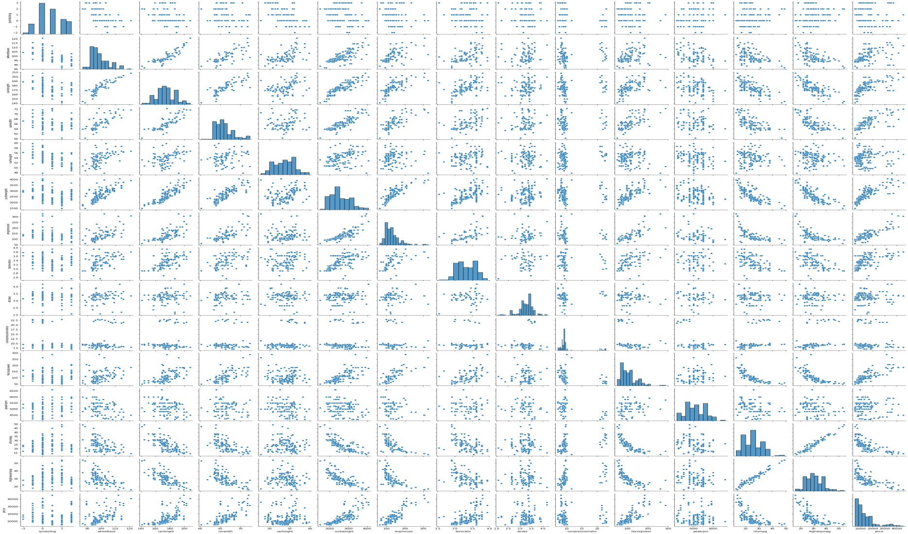
Graphical representation of the dataset showing the numerical and categorical values

Slide 5
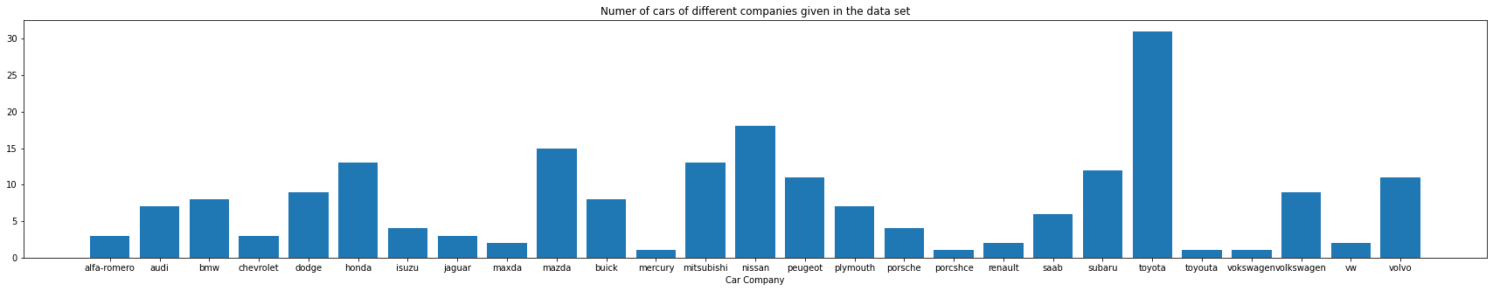
Total Number of car company present in the data set are: (27) 'Toyota' is the company which has maximum number of cars (31)

Slide 6
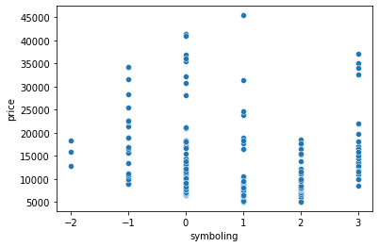
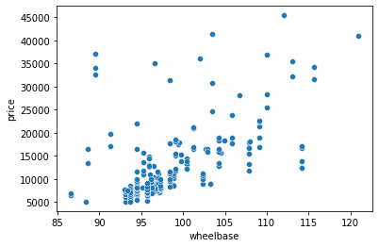
Graphical representation of Numerical variable
Symboling
Wheelbase

Slide 7
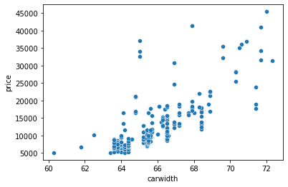
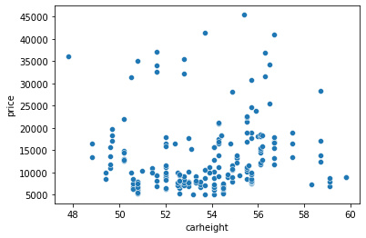
Numerical Variable
Car width
Car height

Slide 8
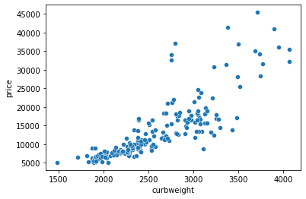
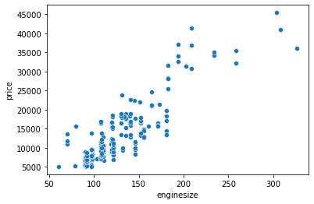
Numerical Variable
Curb weight
Engine size

Slide 9
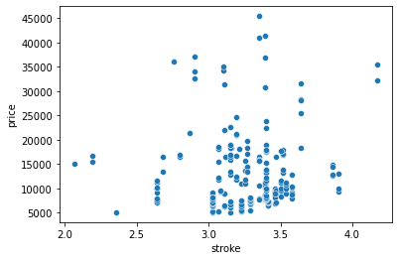
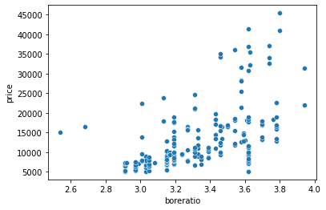
Numerical Variable
stroke
Bore ratio

Slide 10
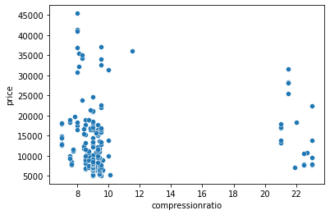
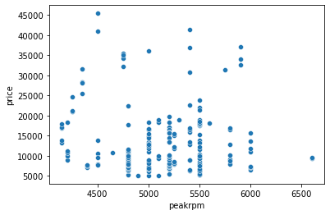
Numerical Variable
Compression ration
Peakrpm

Slide 11
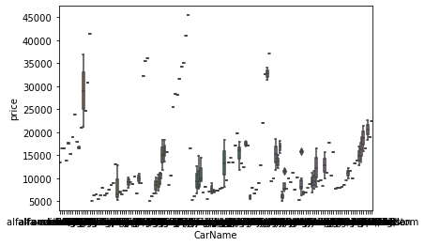
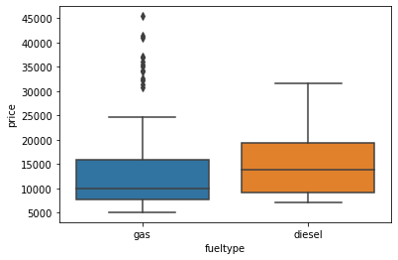
Categorical Variable
The correlation between the car name is high
The consumption of fuel by car is relational

Slide 12
Machine Learning
Regression models employed in the prediction are:
Linear Regression
Ols and VIF
Variance inflation factor
RFE

Slide 13
The outliers should be treated and the feature importance should be considered while predicting the price

Slide 14
Conclusion
Cars with four doors, that uses gas, STD aspirators, sedan car body, forward wheel, front engine location, Mpfi fuel system should be imported and assembled the most as these are the most bought cars from our Univariate analysis.

